Slide 1
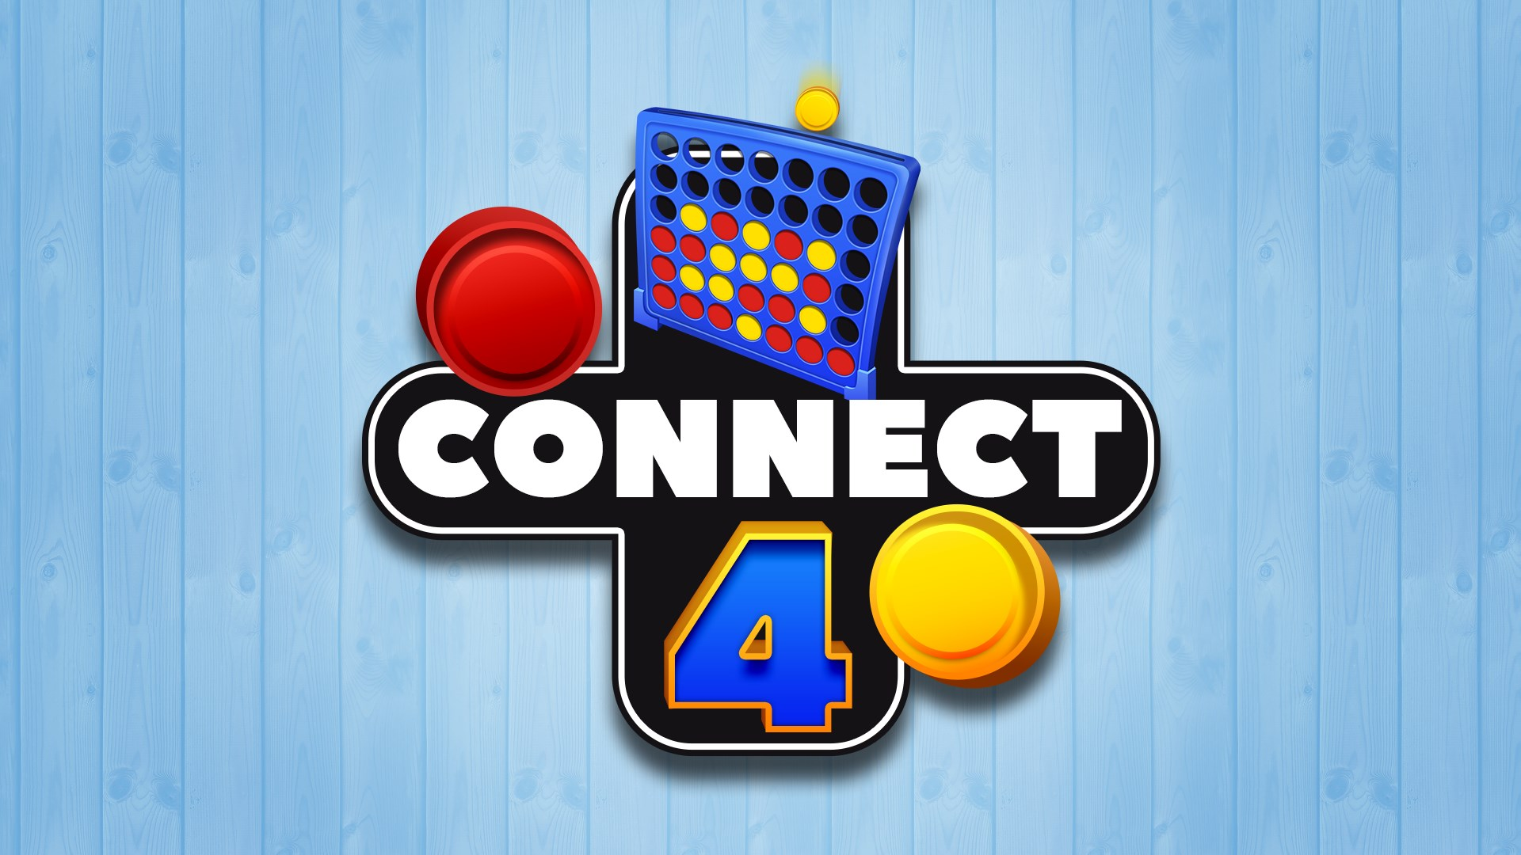
Course:- DIP392
NAME SURNAME, Student I’D: Kushagra Singh, 221ADB063
NAME SURNAME, Student I’D: Pooja Odedara, 221ADB033

Slide 2

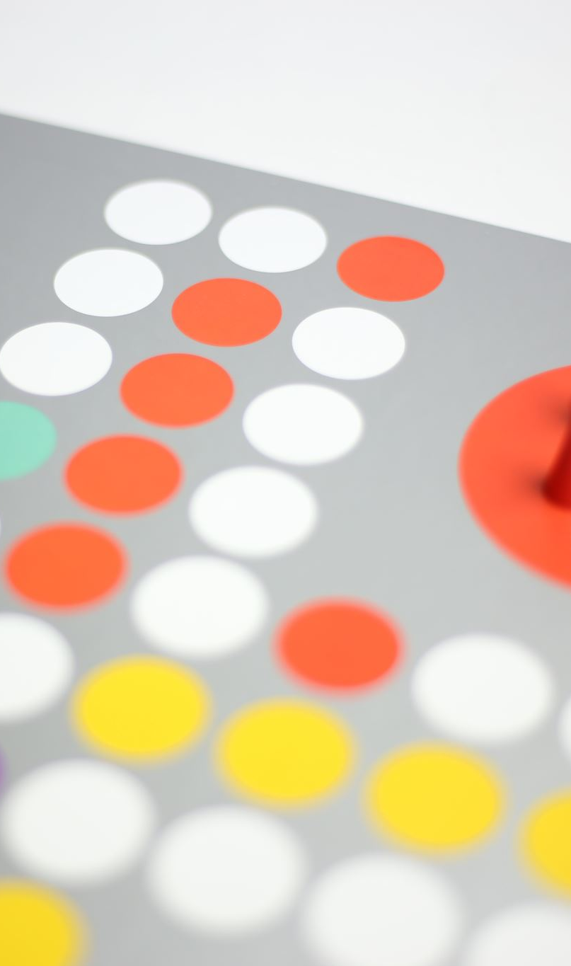
Overview Of The Game Project
The Connect Four game project involves creating a software implementation of the classic two-player connection game. In this game, players take turns dropping colored discs into a vertical grid with the objective of being the first to form a horizontal, vertical, or diagonal line of four of their own discs. The game requires strategic thinking and planning, making it both challenging and entertaining. The project has focus on developing a user-friendly and visually appealing interface, providing an engaging experience for players. The game also has feature a computer AI opponent to allow for single-player gameplay.

Slide 3
Key Features
User Interface: Visually appealing, customizable player colors.
Gameplay Modes: Two Player Mode, Single Player Mode with AI.
Game Mechanics: 7x6 grid, smooth game mechanics.
AI Implementation: Simple AI opponent with randomized moves.
Winning Conditions and Feedback: Win checks, highlighting, real-time feedback.
Customization: Color selection for discs.
Instructions and Usability: Help section, restart options.

Slide 4
Technical Implementation , Requirement Assumptions and Additions
Frontend Development: HTML, CSS, JavaScript
.Responsive Design: Ensuring seamless experience across devices.
Modular Code: Organized JavaScript functions for maintainability.
Assumptions: Basic functionality, user interaction, AI, browser compatibility.
Additions: Game modes, UI enhancements, instructions modal, restart functionality, winning line highlight, dynamic color update, responsive design, CSS animations, error handling, code modularity.

Slide 5
Functional Programming Approach and Benefits
Functional programming (FP) treats computation as the evaluation of mathematical functions.
Key concepts: pure functions, immutability, higher-order functions.
Application in Connect Four:
Pure Functions: checkWin, dropDisc, and updateBoard enhance reliability.
Immutability: Ensures predictable state changes.
Higher-Order Functions: Modular event handling and UI updates.
Conclusion:
FP principles leads to cleaner, maintainable, and reliable code, enhancing the user experience and ease of future updates

Slide 6
Extension and Impact on Design
Extension Overview:
AI Opponent: Upgraded from random moves to a future plan for the Minimax algorithm.
User Interface: Enhanced with CSS Grid, animations, and responsive design.
Customization: Added player disc color selection.
Usability: Instructions modal and restart functionality.
Impact on Design:
AI Logic:
Modular design for easy AI upgrades.
User Experience:
Improved visual feedback and responsiveness.
Customization:
Dynamic color updates enhance user engagement.
Usability:
Clear instructions and easy restart improve accessibility.
Summary:
Extensions led to a more modular, user-friendly, and engaging game, ensuring better performance and future scalability.

Slide 7
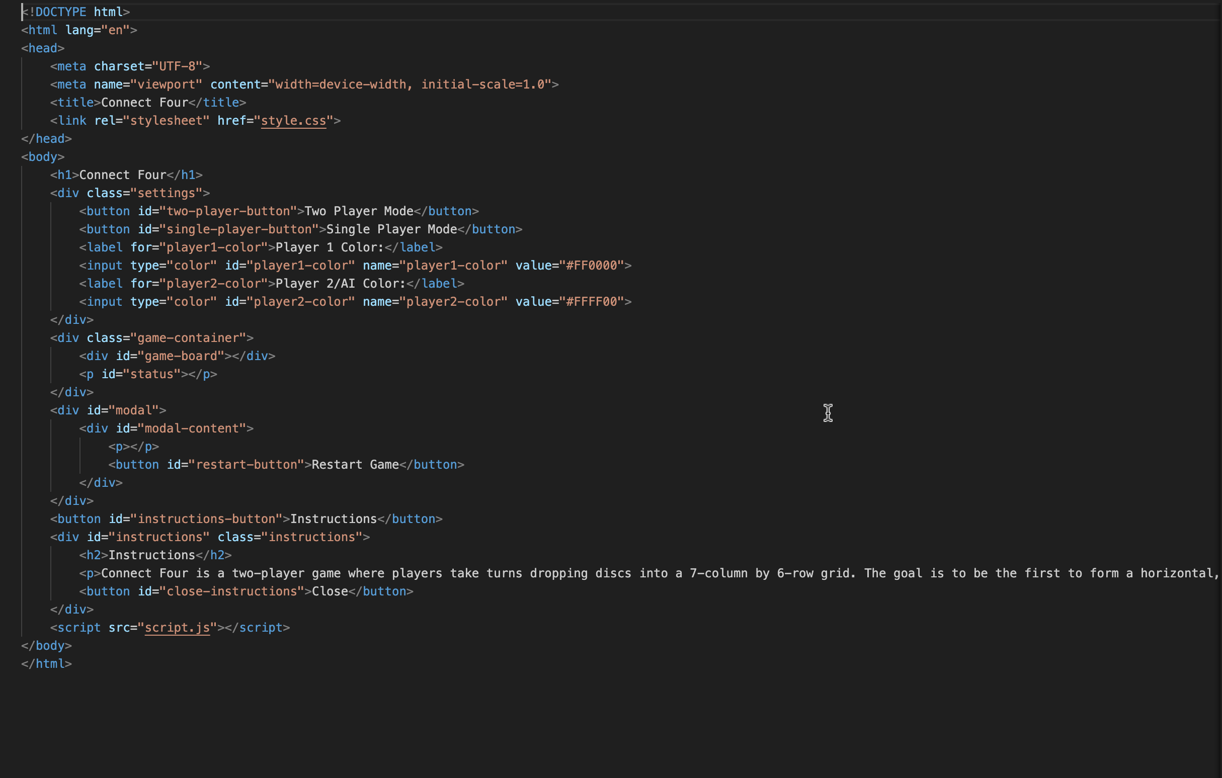
The HTML file for the Connect Four game sets up the structure and interactive elements needed for the game to function. The `<head>` section includes essential metadata and links to the `style.css` for styling. The `<body>` contains key components: the game title (`<h1>Connect Four</h1>`), settings for choosing game mode and disc colors (`<div class="settings">` with buttons and color inputs), and the game board container (`<div id="game-board"></div>`), where the game cells will be dynamically created. Additionally, there are sections for displaying the game status (`<p id="status"></p>`) and a modal (`<div id="modal">`) to show the game result and provide a restart button. The instructions section (`<div id="instructions">`) explains the game rules and is toggled by a button. Finally, the script inclusion (`<script src="script.js"></script>`) links to the JavaScript file, which handles the game logic.

Slide 8
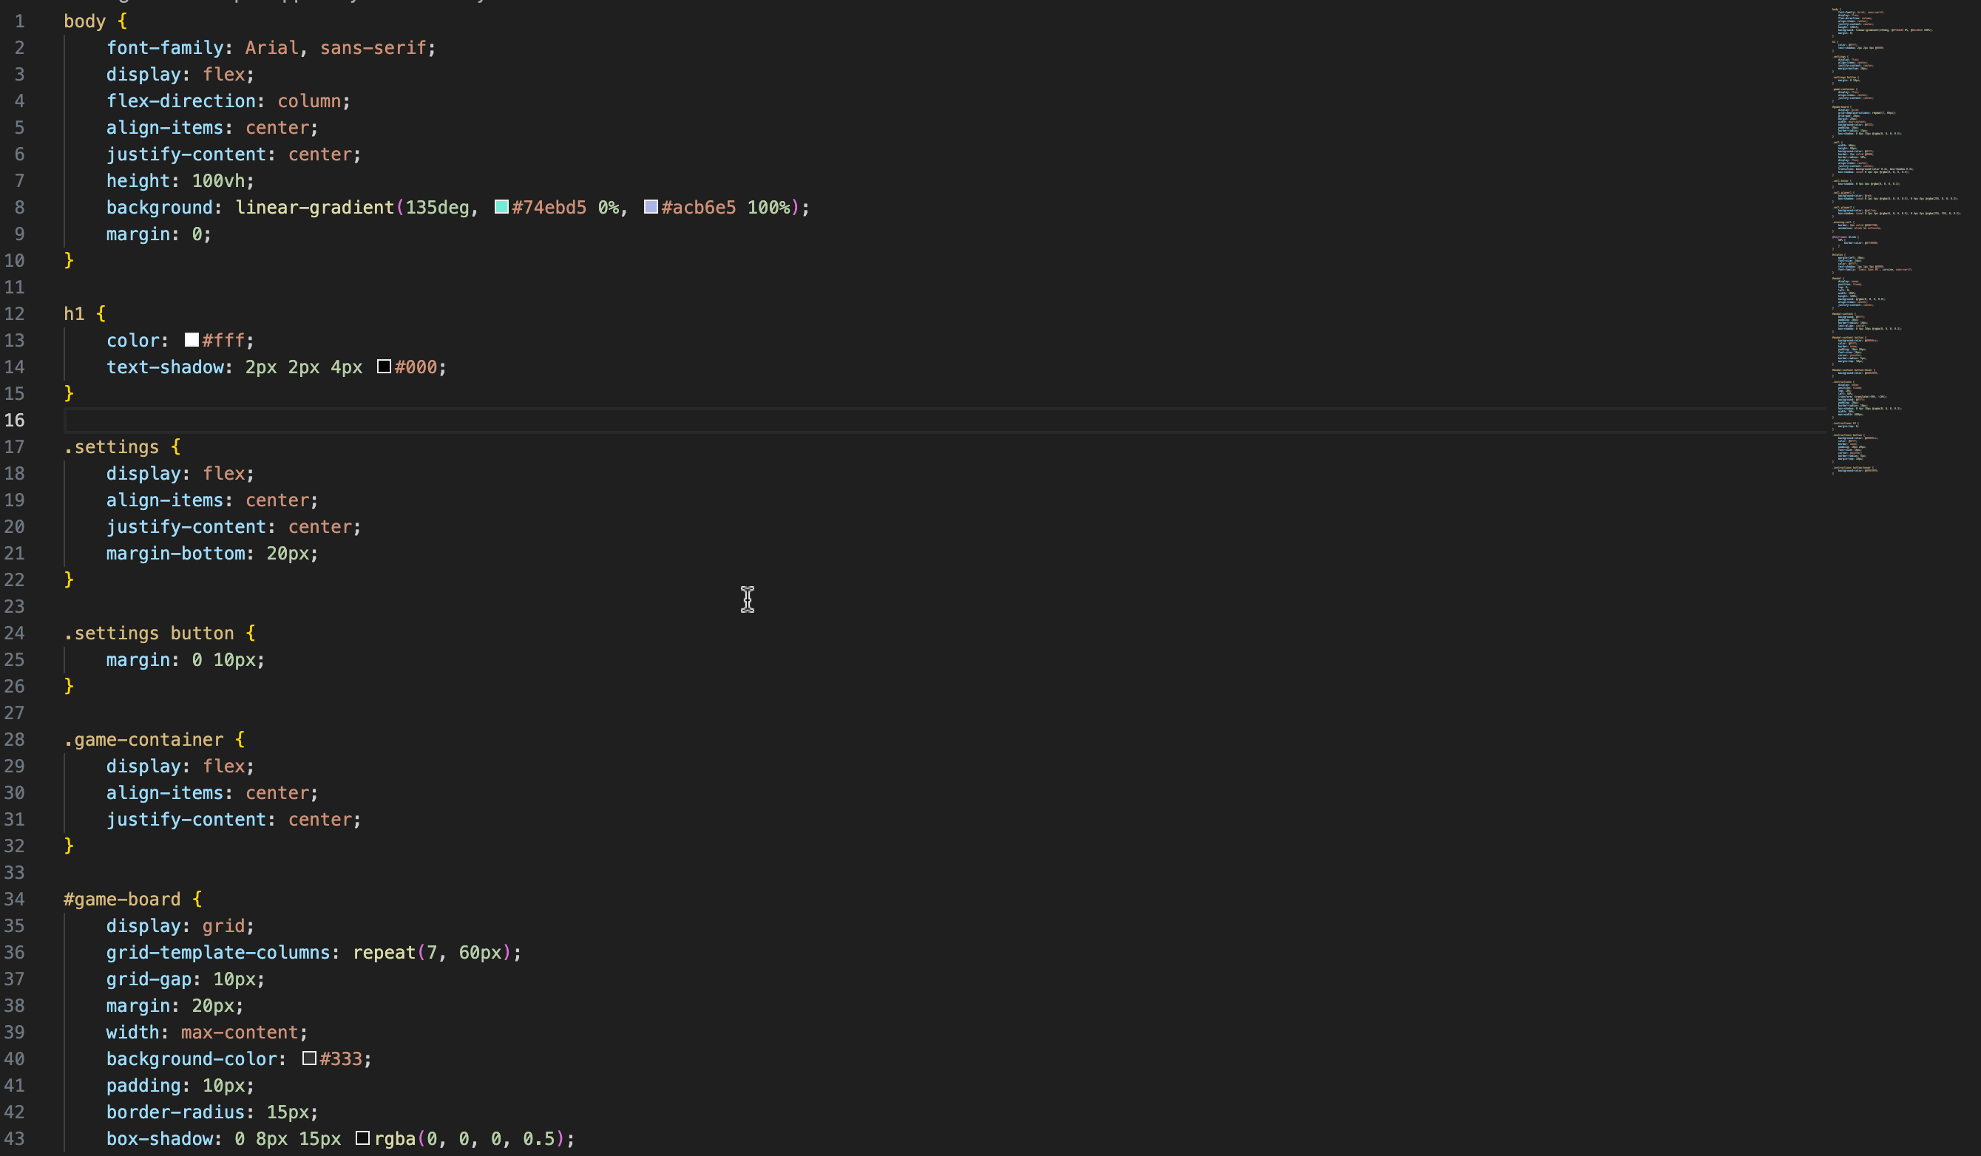
The CSS file defines the visual styling for the Connect Four game, ensuring it looks appealing and user-friendly. The `body` style sets a background gradient and centers the content using Flexbox. The game title (`h1`) is styled with a white color and text shadow for better visibility. The settings section (`.settings`) uses Flexbox to align its elements, including buttons and color inputs, providing a user-friendly interface for game mode selection and color customization. The game board (`#game-board`) is styled as a grid with defined cell dimensions and a dark background, giving it a polished look. Each cell (`.cell`) is styled to appear circular, with hover effects to enhance interactivity. Player-specific styles (`.cell.player1` and `.cell.player2`) and the winning cell animation (`.winning-cell`) add visual cues for game events. Modal and instructions styles ensure these elements are visually distinct and easily accessible.

Slide 9
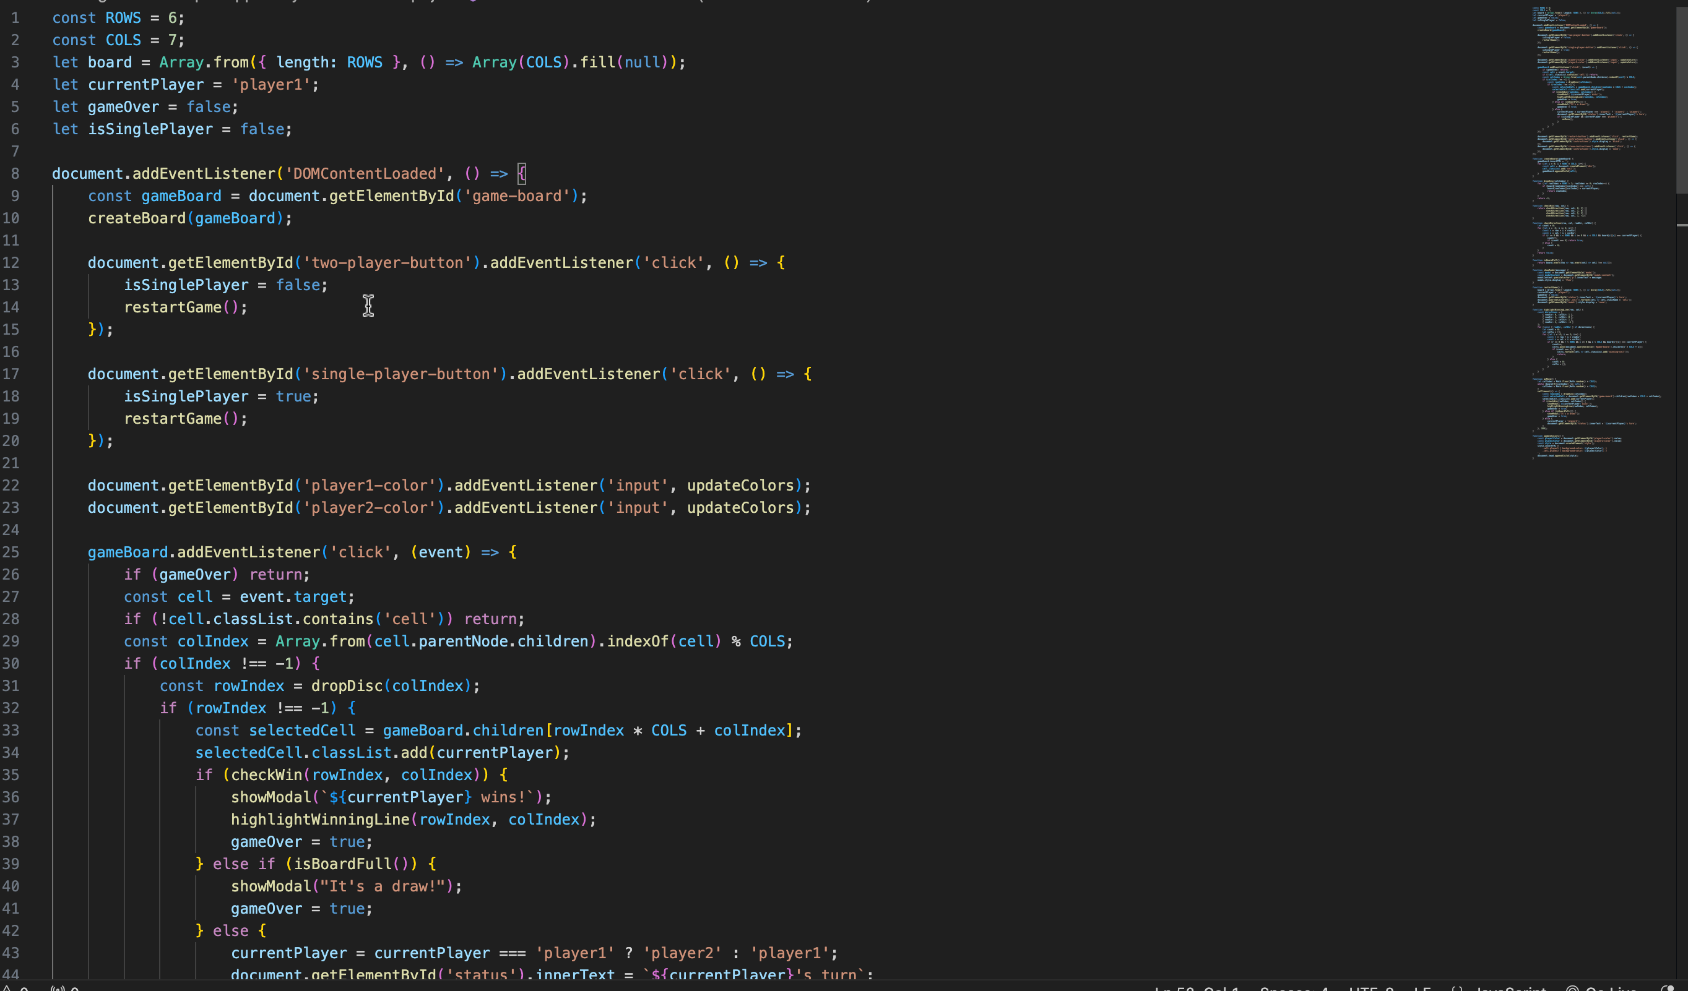
The JavaScript file (`script.js`) brings the Connect Four game to life by handling all the interactive functionalities. It starts by initializing the game state, including the game board array, the current player, and the game mode. Event listeners are set up for game mode buttons, color input changes, and game board clicks. The `createBoard` function dynamically generates the game cells, while `dropDisc` handles disc placement. The core game logic includes checking for a win (`checkWin` and `checkDirection` functions) and updating the game status. The AI move function (`aiMove`) provides basic single-player functionality. Additional functions like `showModal` and `highlightWinningLine` enhance the user experience by showing game results and highlighting the winning discs. The `restartGame` function resets the game state, allowing for new rounds to be played seamlessly.

Slide 10
Testing Strategies and Lessons Learned
Testing Strategies:
Initialization: Verify empty board, initial player.
Player Moves: Validate moves, and handle full columns.
Game Modes: Test two-player and AI functionality.
Customization: Ensure disc color changes.
Win Conditions: Check all win scenarios and draws.
Usability: Test instructions modal, restart function.
Lessons Learned:
Programming: Improved HTML, CSS, JavaScript, and modular coding.
Process: Importance of requirements, design, incremental development.
Management: Time management, feature prioritization, documentation.

Slide 11
DEMONSTRATION
https://kushagrasingh23.github.io/DIP392-KP/

Slide 12

THANK YOU FOR YOUR ATTENTION !!!
TIME FOR Q&A SESSION

